Slide 1

Malicious Uses of Evasive Communications and Threats to Privacy
David McGrew mcgrew@cisco.com
IAB Stopping Malware and Researching Threats (SMART) Meeting @ IETF 104
March 25, 2019
Notes:
This presentation covers malicious uses of evasive communications and the threats posed to privacy. My goal is to present hard data on malware and its behavior and goals, and thus bring some of the perspective of the threat researcher and computer security incident responder into the IETF, and to suggest some research goals that might be useful in the protocol design space.
Background picture: Prague Astronomical Clock. Credit: Wikimedia Commons

Slide 2
Privacy is a human right, and encrypted communication is a cornerstone of modern society
Individual
Organization
Criminals
Corporations
Governments
Individuals
WiFi
Eavesdropper
ISP Cookie
Insertion
Censorship
Espionage
Doxing
Notes:
It is really important to start out with a strong statement about how privacy is a right, and how encryption is a cornerstone of the modern internet. Technologies that support private communication
are a good thing. This talk is about how some malicious actors misuse and abuse those technologies, and their motivations and techniques.

Slide 3
Evasive communication goals and uses
Goal | Benign Use | Malicious Use
Data confidentiality | Data privacy | Hide from defender
Evade blocking | Censorship circumvention | Infection, C2, exfiltration
Visit targeted site(s) without detection | Privacy | Minimize indications of compromise
Communication without detection | Hide circumvention | Hide infection
Goals are applicable to DoH, DoT, eSNI, Domain Fronting, and other protocols
Notes:
The technical goals of evasive communication are listed here.
Data encryption is used to keep data private.
Techniques to evade blocking are used to circumvent censorship, especially by nations that restrict access to the internet
Another evasion goal is to prevent others from knowing what sites on the internet you are visiting
Lastly, the hardest goal of all is to hide the fact that evasive communication is going on.
Note that these goals could be applicable to a number of technologies like DoH, DoT, encrypted TLS SNI, and Domain Fronting

Slide 4
Evasive communication goals and uses
Goal | Benign Use | Malicious Use
Data confidentiality | Data privacy | Hide from defender
Evade blocking | Censorship circumvention | Infection, C2, exfiltration
Visit targeted site(s) without detection | Privacy | Minimize indications of compromise
Communication without detection | Hide circumvention | Hide infection
Goals are applicable to DoH, DoT, eSNI, Domain Fronting, and other protocols
Notes:
Malware operators have uses for all of the technical goals of evasive communication.
Data confidentiality is used to hide the details of its activity from defenders.
Blocking evasion is used to ensure that malware can complete its mission.
Malware wants to hide the sites it connects with to minimize indications of compromise.
Their ideal is to hide the fact of infection for as long as possible.

Slide 5
Client-side attacks on privacy
Organization
Individual
“Remote Administration Tools (RAT) provide the ability to remotely survey the electronic activities of a victim by keylogging, remote desktop viewing, webcam spying, audio-eavesdropping, data exfiltration, and more.”
Syrian Activists Targeted with BlackShades Spy Software (Citizen Lab, 2012)
Notes:
Attacks on privacy can be characterized as being against the clients’ systems, or the servers’ systems. I will call those client-side and server-side.
RATs have been used against privacy in many well-documented instances, so I will focus on that example. This definition of a RAT comes from an article about how the privacy of democracy advocates were targeted by a repressive government.

Slide 6
Client-side attacks against privacy: examples
Over the last decade, Syrian activists have been targeted by malware including DarkComet, Blackshades, Xtreme RAT Trojan, njRAT, ShadowtechRAT, Dark Caracal, and infected Freegate clients
Similar tactics against activists, lawyers, and journalists in Mexico, Azerbaijan, Egypt, and United Arab Emirates have been documented
In many cases, the victims were tricked into installing malware, including infected evasive communications applications
“… all Dark Caracal needed was application permissions that users themselves granted when they downloaded the apps, not realizing that they contained malware,” said EFF Staff Technologist Cooper Quintin. “This research shows it’s not difficult to create a strategy allowing people and governments to spy on targets around the world.”
EFF and Lookout Uncover New Malware Espionage Campaign Infecting Thousands Around the World; Mobile Devices Compromised by Fake Secure Messaging Clients – Hundreds of Gigabytes of Data Stolen (EFF)

Slide 7
Client-side attacks against privacy: examples
Campaign Targeting Syrian Activists Escalates with New Surveillance Malware (EFF)
HOW THE BOY NEXT DOOR ACCIDENTALLY BUILT A SYRIAN SPY TOOL (WIRED)
Quantum of Surveillance: Familiar Actors and Possible False Flags in Syrian Malware Campaigns (Citizen Lab and EFF)
A CALL TO HARM - New Malware Attacks Target the Syrian Opposition (Citizen Lab)
When Governments Attack: Malware Targeting Activists, Lawyers, and Journalists (Eva Galperin, EFF)
Commercial spyware unleashed against Mexican Political Activists (SOPHOS, 2017)
False Friends: How Fake Accounts and Crude Malware Targeted Dissidents in Azerbaijan (Amnesty International, 2017)
PROMINENT HUMAN RIGHTS ACTIVISTS IN EGYPT TARGETED BY SOPHISTICATED HACKING ATTACKS (The Intercept, 2017)
Egyptian activists and media targeted by phishing attacks (Reuters, 2019)
The UAE Spends Big on Israeli Spyware to Listen In on a Dissident (Foreign Policy, 2016)
Syrian Activists Targeted with BlackShades Spy Software (Citizen Lab, 2012)
EFF and Lookout Uncover New Malware Espionage Campaign Infecting Thousands Around the World (EFF)
How the FBI found Miss Teen USA’s webcam spy (Ars Technica, 2013)

Slide 8
Server-side attacks on privacy
Data Center,
Cloud Provider,
CDN,
Enterprise
Individual
"[With] any large network, I will tell you that persistence and focus will get you in, will achieve that exploitation without the zero days … There's so many more vectors that are easier, less risky and quite often more productive than going down that route."
Rob Joyce, NSA TAO, in NSA HACKER CHIEF EXPLAINS HOW TO KEEP HIM OUT OF YOUR SYSTEM (WIRED, 2016)
Notes:
Now let’s move on to server-side attacks.
This quote is from the head of NSA TAO. The confidence that he expresses here should make us consider the threat to privacy of all of the personally sensitive information stored in DCs, cloud providers, CDNs, and enterprises.
This talk could be subtitled: if you are paranoid about NSA SIGINT, why aren’t you paranoid about NSA Tailored Access Operations?

Slide 9
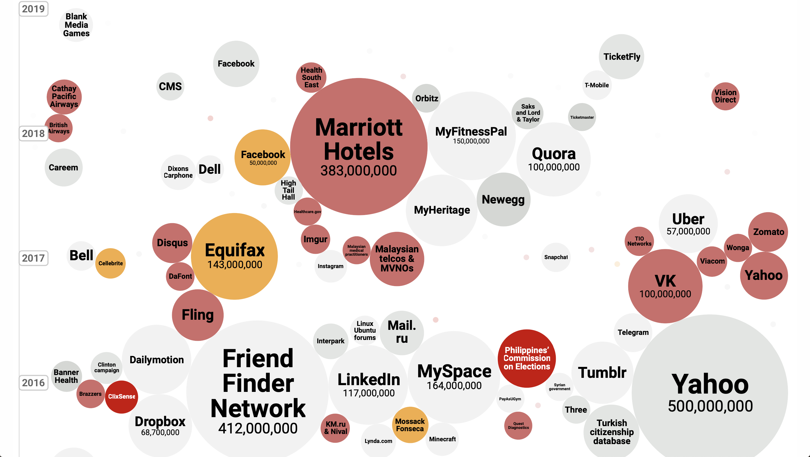
Source: informationisbeautiful.net/visualizations/worlds-biggest-data-breaches-hacks/ with filter=hacked
Notes:
Server-side hacks and data breaches are too prevelant to enumerate. This graphic, which shows only breaches due to malicious activity, illustrates that fact.
A good example of how these breaches are relevant to individual privacy: homosexuality is illegal in 70 countries; how many people were exposed in the dating-site hacks? Three major hacks revealed the sensitive information of hundreds of millions of people.
References:
Adult dating site hack exposes millions of users (Channel 4, 2015), AdultFriendFinder network hack exposes 412M accounts (ZDNet, 2016) , Online Cheating Site AshleyMadison Hacked (Krebs, 2015)
Hackers Access At Least 100,000 Snapchat Photos And Prepare To Leak Them, Including Underage Nude Pictures (Business Insider, 2014)

Slide 10
Server-side attacks on privacy
Initial
Infection
Secondary
Download
Lateral
Movement
Command
& Control
Data
Exfiltration
Exploitation
Notes:
This illustration shows how important communication is to malware activity. From the malware operator’s point of view, evasion is key to success.

Slide 11
Stolen Passwords
… The monster data dump goes by the prosaic “Collection #1” and contains 1.16B unique combinations of email addresses and passwords, but only 772 million unique email addresses. It’s the largest data dump to ever be loaded into Have I Been Pwned, and it represents a sort of meta-breach collection rather than the results of any single security exploit or corporate security shortfall.
New Massive Security Breach Exposes 773 Million Passwords (ExtremeTech, 2019)
Notes:
Password hashes are often stolen on the server side and then reversed and exploited; this is a significant threat to privacy.

Slide 12
Malware’s use of evasive communication Observed in malware sandbox with strong convictions (> 5 AV signatures excluding adware)
TLS sessions | 1,894,926
Nonstandard ports | 2.37%
Tor | 3.42%
Ultrasurf | 0.214%
Psiphon | 0.0261%
Torch | 0.0541%
Citrio | 0.0867%
1stbroswer | 0.00100%
Source: Blake Anderson
Notes:
Observations of malware communication reveals that evasive communications techniques are used. The most important observations are:
1. Communications protocols designed specifically for evasion are less than ten percent of traffic.
Sophisticated evasion techniques are in regular use.
There is a diversity of evasive applications that are in use.
Note: these numbers are a lower bound; a more detailed analysis of the data would certainly reveal more uses of evasive applications

Slide 13
Malware’s use of evasive communication Observed in malware sandbox with strong convictions (> 5 AV signatures excluding adware)
TLS sessions | 1,894,926
Nonstandard ports | 2.37%
Tor | 3.42%
Ultrasurf | 0.214%
Psiphon | 0.0261%
Torch | 0.0541%
Citrio | 0.0867%
1stbroswer | 0.00100%
Secondary downloads and C2
dropbox.com. dropboxusercontent.com. onedrive.com, drive.google.com,
docs.google.com, googleusercontent.com, githubusercontent.com, github.com
Source: Blake Anderson
Notes:
For completeness, it is worth noting that much of the TLS communication used by malware goes to publicly accessible services like dropbox or github or google docs.
Malware uses these sites as a way to deliver malware, for command and control, and for data exfiltration.

Slide 14
Evasion blowback against privacy
PII
PII
Individual
Censorship
Privacy Network
Data Center
Examples:
LGBT
Religious minority
Democracy advocate
Journalist
PII
Notes:
This presentation can be summed up with this example of privacy blowback (unintended consequence of that undermines original goals).
An individual seeking privacy uses evasive communication to maintain session privacy, but then has their privacy subverted by a malicious actor using evasive communication to steal their personal information from the data center.
This scenario applies to religious minorities, LBGT (as mentioned earlier), democracy advocate, journalists, and others

Slide 15
Research Questions
Can malware’s use of evasive technology be further characterized?
Can evasive technologies prevent malware from utilizing their services without reducing privacy for other users?
Can an evasive client or OS provide a strong assurance of the absence of malicious/unauthorized communication to its user or admin?
How can protocol designers prevent or mitigate malicious uses?
Notes:
So what research questions can we crystalize from this presentation? This is important to consider in the context of the IRTF.
There are several challenges that we can put in front of the research community.

Slide 16
Conclusions
We need to defend against all threats to privacy and security
Evasive communication techniques are used by malicious actors
Open research questions
Notes:
In conclusion, we need to defend against all threats to privacy and security.
It would be wrong to think that security and privacy are always antithetical, because security is needed to protect against client- and server-side attacks on privacy.
While evasive communications technologies have important benign uses, they are also being used by malicious actors.
There are open research questions; how can we keep the benign uses, but squelch the malicious ones?

Slide 17
THANKS
Notes:
Thanks for your attention.

